Slide 1


How robotics is transforming surgery and patient care ?
Presented by Golam Muin-U-Ddin Chishti

Slide 2

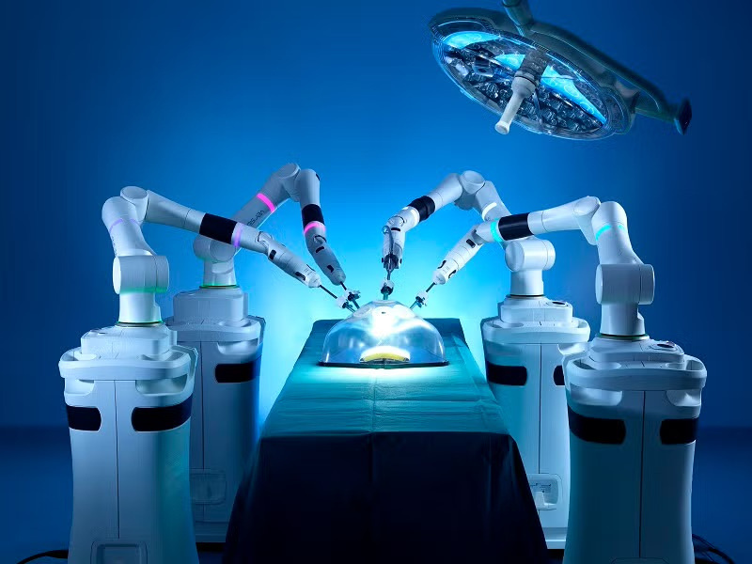
Robots in surgery
1
2
3
4
Robot was invented by George Devol in 1954.
The first robot to participate in a surgery on a human was the Arthrobot in 1983
PUMA 560, an industrial robotic arm that was used in 1985 to orient a needle for a stereotactic brain biopsy.
ROBODOC (1992). This system was one of the first active robotic systems to perform surgical actions and the first to receive FDA approval (in 2008 for the US market).

Slide 3

Higher Precision : Up to 40% more accurate operations.
Faster Procedures : 25% reduction in surgery time.
Fewer Complications : 30% decrease in surgical errors.
Quicker Recovery : 15% shorter healing time.
Better Efficiency : 20% improved surgeon workflow.
Cost Savings : 10% lower overall healthcare costs.
Overall: Safer surgeries, faster recovery, and improved patient outcomes.
Benefits of Robot in Surgery

Slide 4
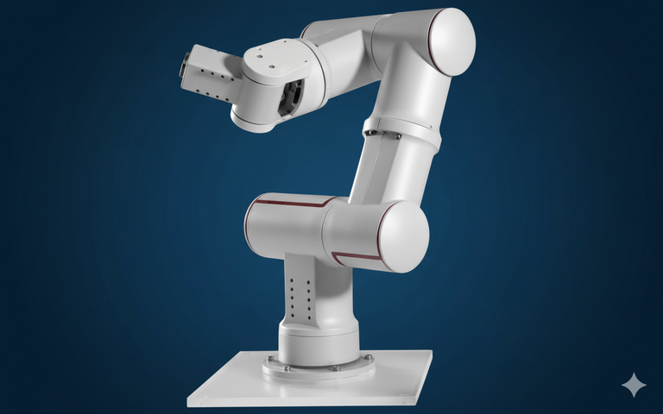

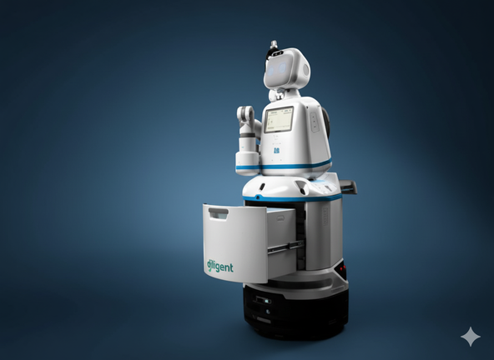

Robots in surgery and paitent care
Acrobot
NeuroArm
Moxi
Paro

Slide 5
Very high cost of purchase and maintenance.
Requires extensive surgeon training and experience.
Possible technical or software failures during surgery.
No tactile feedback, reducing the sense of touch.
Limited access in smaller or low-resource hospitals.
Longer setup time before procedures.
Ethical and legal issues over errors and data privacy.
Disadvantages of Robot in Surgery and Patient care

Slide 6


Thank You

